Slide 1
Handling Evidence
Digital Forensics, Day 3

Slide 2
Class Objectives
By the end of class today, students will be able to:
Use Autopsy to view and tag evidence from emails.
Analyze SMS messages offline in Kali Linux.
Decode hex data in the iPhone image
Prepare a preliminary report using the Group Evidence Worksheet.

Slide 3
Warm Up Activity
In this activity, students will review the steps for exporting data from the iPhone image.
Instructions sent via Slack.
10 minutes

Slide 4
Exporting Data Review

Slide 5
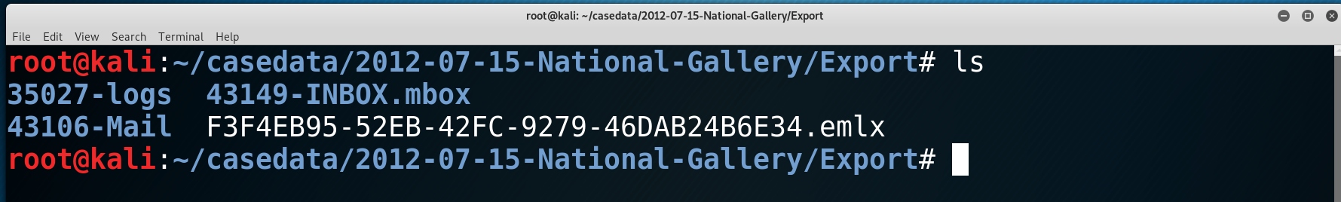
Warm-Up Review
Exporting the INBOX.mbox directory.

Slide 6
“What’s in Tracy’s Emails?”

Slide 7
What’s in Tracy’s Emails?
INBOX.mbox/Messages

Slide 8
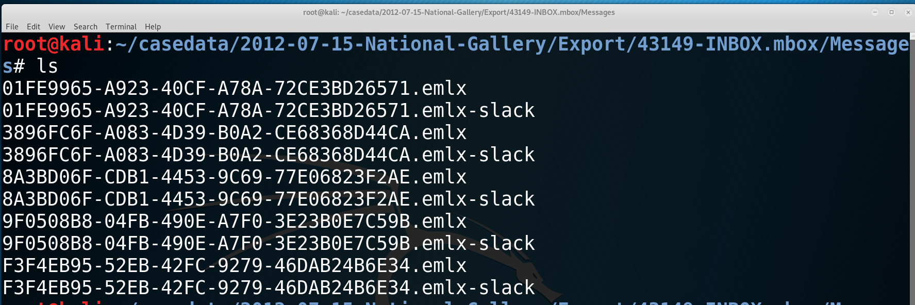
Instructor Demo
Displaying the email messages in the INBOX.mbox/Messages folder.
Open a terminal window and cd to the directory that contains the INBOX.mbox directory.
cd to the Messages folder and display the .emlx files.

Slide 9
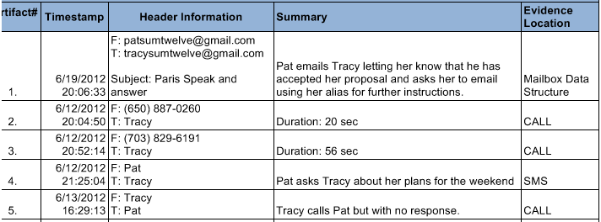
Tracy’s Emails
Search for Contact Information
In the next activity, you will:
Work in groups to examine Tracy's email messages to find any contacts from the scenario.
Look at any email attachments.
Tag any items of interest in Autopsy.

Slide 10
Activity: What’s in Tracy’s Emails?
In this activity, you will use Autopsy to examine Tracy’s email correspondence and generate a list of contacts and their email addresses.
Instructions sent via Slack.
20 Minutes

Slide 11
What’s in Tracy’s Emails?

Slide 12
Tracy’s Email Review
What evidence did you find?

Slide 13
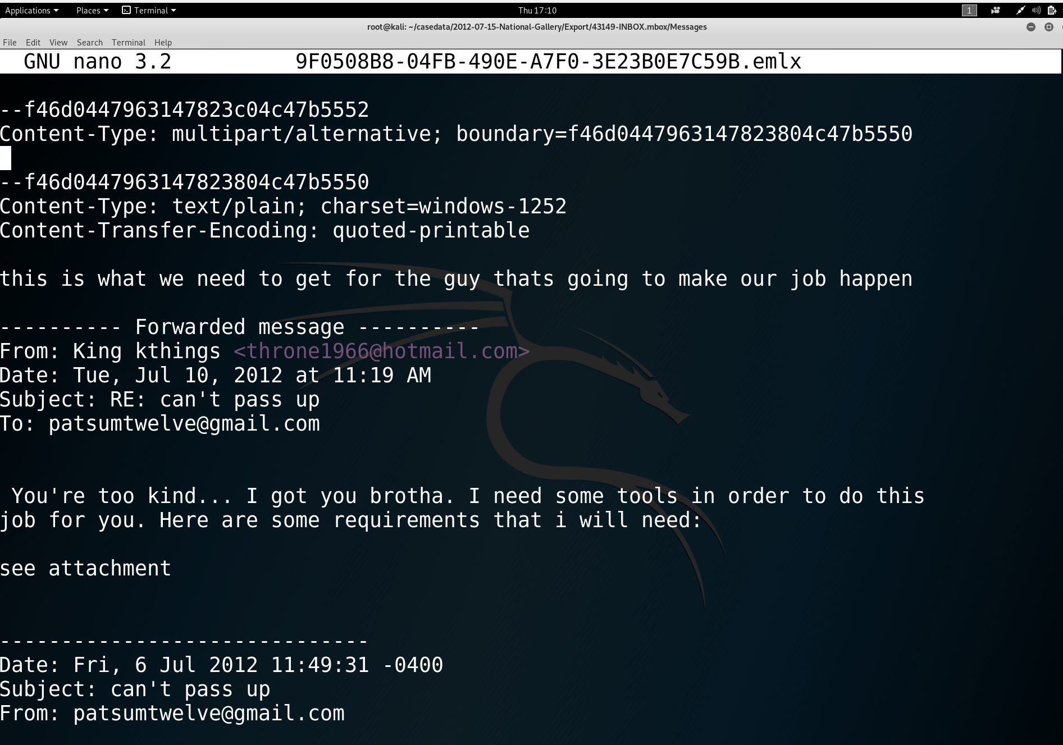
Tracy’s Email Review
Email 9F0508B8-04FB-490E-A7F0-3E23B0E7C59B.emlx

Slide 14
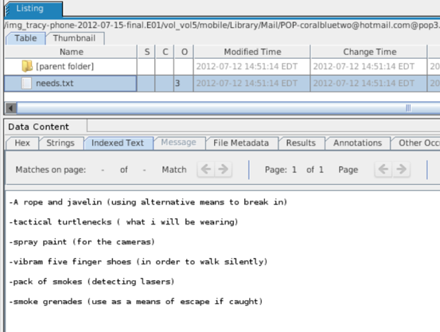
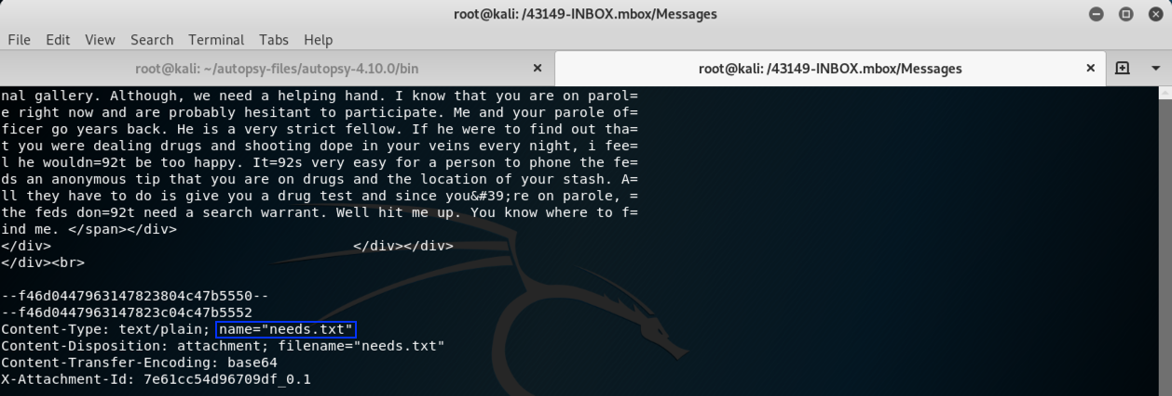
Tracy’s Email Review
The email has an attachment.

Slide 15
“Who is Tracy Texting?”

Slide 16
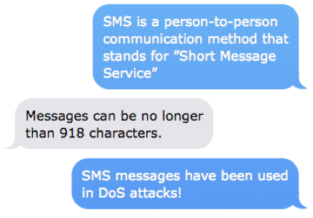


What is an SMS?
Notes:
Emoji Characters

Slide 17
iPhone SMS
Steps to view SMS entries in an iPhone image
From the Tools menu, select File Search by Attribute.
Click the box next to Name and type sms.db.
Click the Search button.
Now select sms.db from the Listing pane.
Select the Indexed Text tab in the Data Content pane to see Tracy’s emails.

Slide 18
Activity: Who is Tracy Texting?
In this activity, you will view the SMS text messages on Tracy’s iPhone to gather more information about the case.
Instructions sent via Slack.
15 Minutes

Slide 19
Review: Who is Tracy Texting?
1. Use the file search to find the sms database.
2. View the messages in the Data Content pane.
3. Analyze the text messages and phone numbers to establish any connections to the case and answer the following questions:
What is Terry’s phone number?
What is Pat’s phone number?
What was the fraudulent number that texted about a gift card? Is it relevant to the case? Why or why not?
4. Update your Evidence Worksheet with any additional evidence.

Slide 20
Review: Who is Tracy Texting?
What is Terry’s phone number?
703-829-6071. It is evident because she talks about her dad multiple times and Tracey informs her she cannot afford private school anymore.
What is Pat’s phone number?
571-308-3236. The text message refers toTracey as sis. A response message from Tracey identifies him as “pat”.
What was the fraudulent number that texted about a gift card? Is it relevant to the case?
206-910-0932. Looking at the website link that went with the message, it appears this text was spam. So, no it is not relevant.

Slide 21
Review: Who is Tracy Texting?
4. Update your Evidence Worksheet with any additional evidence.
Carry
Email Cat2welve@gmail.com, Cat2welve@gmail.com Carrysum2012@yahoo.com,
Phone: +1 (202) 725-2124
Alex J
Email Alex.jfam11@gmail.com, Alexjfam11@gmail.com
Phone: +1 (205) 208-5299
Drex Mustafar
Email: bubbahotep2012@hotmail.com
Perhem Shien
Email: Perhem.shien@gmail.com, supershien@live.com

Slide 23
Decoding Hex Data in Tracy’s iPhone

Slide 24
Sometimes
data we uncover will only
be readable in a hexadecimal numbering format.

Slide 25
Why is Hexadecimal Important?
The ability to read a hex dump will allow you to explore a whole new space of evidence that could not be read in the browsing data.
Hex is used to display the location in memory at which data is stored.
Hex is used to decode data, such as executable code in a memory dump or a malicious document embedded in an image or network log.
Refresher: All information is stored in a computer as binary 1s and 0s.
We need to encode this information into human-readable formats.
Hexadecimal is the most common representation of binary encoding.

Slide 26
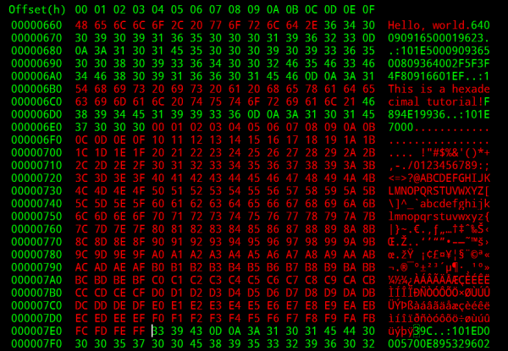
Why is Hexadecimal Important?
As it pertains to our forensics investigation, the ability to read a hex dump will allow us to explore a whole new space of evidence they could not read in the browsing data.

Slide 27
In order to better understand and decode hex, we’ll need to take a closer look at ASCII and decimal characters.

Slide 28
Basic Character Encoding
In order to better understand and decode hex, we’ll need to take a closer look at ASCII and decimal characters.
We can visualize the characters that represent a computer's data by using a cipher.
These ciphers generally have a lookup table we use to interpret the meanings of encoded texts:
Example:
Plain alphabet : a b c d e f
Cipher alphabet: p h q g i u
Message: abc -> phq.

Slide 29
ASCII and The Decimal System
ASCII stands for the American Standard Code for Information Interchange.
It is used to represent computer-stored characters in a human-readable format.
Look down at you keyboards. Every character is part of ASCII: Upper and lowercase letters, special characters (!@#$ etc.), numericals (1,2,3,4…)
The Decimal system is a little more limited.
Consists of the characters 12 3 4 5 6 7 8 9.
The limited amount of characters doesn’t mean we can’t convey complex information. In fact, anything we write in ASCII can be converted in decimal format:
Example:
ASCII: A, B, C. It's easy as 1, 2, 3!
Decimal: 65 44 32 66 44 32 67 46 32 73 116 39 115 32 101 97 115 121 32 97 115 32 49 44
32 50 44 32 51 33

Slide 30
ASCII-Decimal Chart and Encoding
ASCII Chart
ASCII-Decimal Converter

Slide 31
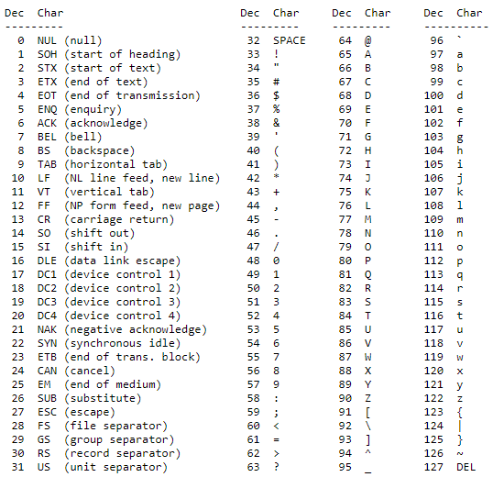
ASCII - Decimal Conversion
ASCII characters for numerical digits start at the decimal number 48 and end at 57.
48 (ASCII) = 0 (Decimal),
49 (ASCII) = 1 (Decimal),
57 (ASCII) = 9 (Decimal)
The ASCII upper letters start at the decimal number 65 and end at 90 in the ASCII table.
A (ASCII) = 65 (Decimal),
B (ASCII) = 67 (Decimal)
The ASCII lowercase letters start at decimal number 97 and end at 122.
a (ASCII) = 97 (Decimal)
b(ASCII) = 98 (Decimal)

Slide 32
Hexadecimal
Data can more efficiently be stored and represented by encoding using the hexadecimal number system.
The hex system uses 16 symbols to represent the base values.
It's a base 16 system: the base numbers range from 0-9 and then the letters A-F (which represent 12-16)
base 16: 0 1 2 3 4 5 6 7 8 9 A B C D E F

Slide 33
Hex
Hex uses 16 characters to represent the base value. In other words, it is a base 16 system
The base numbers range from 0-9 and then letters A-F represent 11, 12, etc. (A = 11, B= 12, C =13 etc.)
Dec. | Hex. | Dec. | Hex.
0 | 0 | 8 | 8
1 | 1 | 9 | 9
2 | 2 | 10 | A
3 | 3 | 11 | B
4 | 4 | 12 | C
5 | 5 | 13 | D
6 | 6 | 14 | E
7 | 7 | 15 | F
Dec. | Hex. | Dec. | Hex.
16 | 10 | 24 | 18
17 | 11 | 25 | 19
18 | 12 | 26 | ?
19 | 13 | 27 | ?
20 | 14 | 28 | ?
21 | 15 | 29 | ?
22 | 16 | 30 | ?
23 | 17 | 31 | ?
What do you think comes next?

Slide 34
Hex
Hex uses 16 characters to represent the base value. In other words, it is a base 16 system
The base numbers range from 0-9 and then letters A-F.
Dec. | Hex. | Dec. | Hex.
0 | 0 | 8 | 8
1 | 1 | 9 | 9
2 | 2 | 10 | A
3 | 3 | 11 | B
4 | 4 | 12 | C
5 | 5 | 13 | D
6 | 6 | 14 | E
7 | 7 | 15 | F
Dec. | Hex. | Dec. | Hex.
16 | 10 | 24 | 18
17 | 11 | 25 | 19
18 | 12 | 26 | 1A
19 | 13 | 27 | 1B
20 | 14 | 28 | 1C
21 | 15 | 29 | 1D
22 | 16 | 30 | 1E
23 | 17 | 31 | 1F
And after 1F?

Slide 35
Hex
Hex uses 16 characters to represent the base value. In other words, it is a base 16 system
The base numbers range from 0-9 and then letters A-F.
Dec. | Hex. | Dec. | Hex.
0 | 0 | 8 | 8
1 | 1 | 9 | 9
2 | 2 | 10 | A
3 | 3 | 11 | B
4 | 4 | 12 | C
5 | 5 | 13 | D
6 | 6 | 14 | E
7 | 7 | 15 | F
Dec. | Hex. | Dec. | Hex.
16 | 10 | 24 | 18
17 | 11 | 25 | 19
18 | 12 | 26 | 1A
19 | 13 | 27 | 1B
20 | 14 | 28 | 1C
21 | 15 | 29 | 1D
22 | 16 | 30 | 1E
23 | 17 | 31 | 1F
Dec. | Hex. | Dec. | Hex.
32 | 20 | 40 | 28
33 | 21 | 41 | 29
34 | 22 | 42 | 2A
35 | 23 | 43 | 2B
36 | 24 | 44 | 2C
37 | 25 | 45 | 2D
38 | 26 | 46 | 2E
39 | 27 | 47 | 2F

Slide 36

Character Encoding
ASCII → Decimal → Hexadecimal
A, B, C.
It's easy as
1, 2, 3!
65 44 32 66 44 32 67 46 32 73 116 39 115 32 101 97 115 121 32 97 115 32 49 44 32 50 44 32 51 33
41 2C 20 42 2C 20 43 2E 20 49 74 27 73 20 65 61 73 79 20 61 73 20 31 2C 20 32 2C 20 33 21
Which decimal and hexadecimal characters represent “A” “B” and “C”?
Remember: every character, even commas and spaces, are encoded.

Slide 37
Character Encoding
ASCII → Decimal → Hexadecimal
A, B, C.
It's easy as
1, 2, 3!
65 44 32 66 44 32 67 46 32 73 116 39 115 32 101 97 115 121 32 97 115 32 49 44 32 50 44 32 51 33
41 2C 20 42 2C 20 43 2E 20 49 74 27 73 20 65 61 73 79 20 61 73 20 31 2C 20 32 2C 20 33 21
Note the sequential order of 65, 66, 67 and 41, 42, 43.
Each separate by the character for comma [ , ] and space [ ].

Slide 38
But Why Hex?
Hexadecimal is the most compact of all the Encoding systems we’ve looked at.
Remember, all disk data is ultimately represented as 1s and 0s.
You may recall from our Cryptography unit, conveying information with only 1’s and 0’s is not efficient.
For example:
“A, B, C. It's easy as 1, 2, 3!” =
01000001 00101100 00100000 01000010 00101100 00100000 01000011 00101110 00100000 00001010 01001001 01110100 00100111 01110011 00100000 01100101 01100001 01110011 01111001 00100000 01100001 01110011 00100000 00001010 00110001 00101100 00100000 00110010 00101100 00100000 00110011 00100001 00001010

Slide 39

But Why Hex?
Hexadecimal is the most compact of all the Encoding systems we’ve looked at.
Remember, all disk data is ultimately represented as 1s and 0s.
You may recall from our Cryptography unit, conveying information with only 1’s and 0’s is not efficient.
So, programs save space by converting binary to encoding formats.
Hex is the more compact than ASCII and Decimal.

Slide 40
Activity: Decoding Hex Data in Tracy’s iPhone
In this activity, you will work through a few simple hex decodings. Then, you will work with a hex dump from Tracy’s iPhone data in the Encase image file.
Instructions sent via Slack.
20 Minutes

Slide 41
Hex Data and Tracy’s Phone

Slide 42
Decoding Hex Review:
Decode the following:
48 65 6c 6c 6f 20 57 6f 72 6c 64
54 65 73 74 69 6e 67 20 31 32 33 21
41 6e 64 72 65 77
31 20 32 20 33 20 34 20 35 20 36

Slide 43
Decoding Hex Review:
Decode the following:
48 65 6c 6c 6f 20 57 6f 72 6c 64 = Hello World
54 65 73 74 69 6e 67 20 31 32 33 21 = Testing 123!
41 6e 64 72 65 77 = Andrew
31 20 32 20 33 20 34 20 35 20 36 = 1 2 3 4 5 6

Slide 44
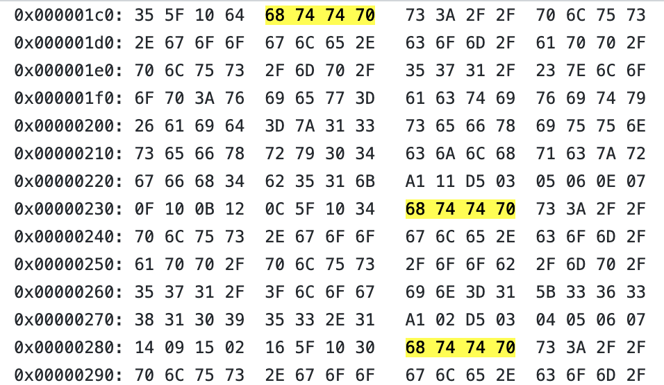
Decoding Hex
Note: Knowing that http in hex is 68 74 74 70 , we can identify URLs in this hex sequence.

Slide 45
Decoding Hex
Which URLs did you find?

Slide 46
Decoding Hex
Which URLs did you find?
https://plus.google.com/app/plus/mp/571/#~loop:view=activity&aid=z13sefxiuunsefxry04cjlhqczrgfh4b51k
https://plus.google.com/app/plus/oob/mp/571/?login=1
https://plus.google.com/app/plus/mp/571/?login=1
https://plus.google.com/app/plus/oob/mp/571/?login=1
https://accounts.google.com/ServiceLoginAuth
https://plus.google.com/app/plus/mp/571/?login=1
http://www.google.com/search?q=gorgonzola&ie=UTF-8&oe=UTF-8&hl=en&client=safari

Slide 47
Decoding Hex
What do the URLs indicate?
These URLs show that Tracy was browsing Google+.
It's unclear from the browsing history alone, but the repeated visits to the `login` endpoint may suggest an attempt to break into an account (as opposed to a single successful login).
And the final URL indicates that Tracy searched for "Gorgonzola" on Google, using her Safari web browser.

Slide 48
Decoding Hex
How Browsing Data can be used:
Browsing history, along with timestamps, could provide an alibi for Tracy
Visiting peoples' Google+ profiles proves Tracy is in contact with them.
This can be used as evidence that she knows someone she claims not to or to prove a link to another party in the investigation— a common objective when building conspiracy cases.
Browsing history provides clues as to Tracy's interests.
Searches related to the crime under investigation can be used as evidence against her.
For instance: demonstrating that an individual accused of developing improvised explosives indeed downloaded improvised explosive handbooks is strong evidence against them.

Slide 49
Activity: What was Tracy’s Involvement?
In this activity, you will work in groups to finish documenting their finding and conclusions.
Instructions sent via Slack.
45 Minutes

Slide 50
What’s in Tracy’s Emails?

Slide 51
Let’s Review: Case Scenario
What was Tracy’s Involvement in the case?
Who else is a person of interest?
What evidence did they gather?
Any Questions?

Slide 52
Class Objectives
By the end of class today, students will be able to:
Use Autopsy to view and tag evidence from emails.
Analyze SMS messages offline in Kali Linux.
Decode hex data in the iPhone image
Prepare a preliminary report using the Group Evidence Worksheet.

